Slide 1
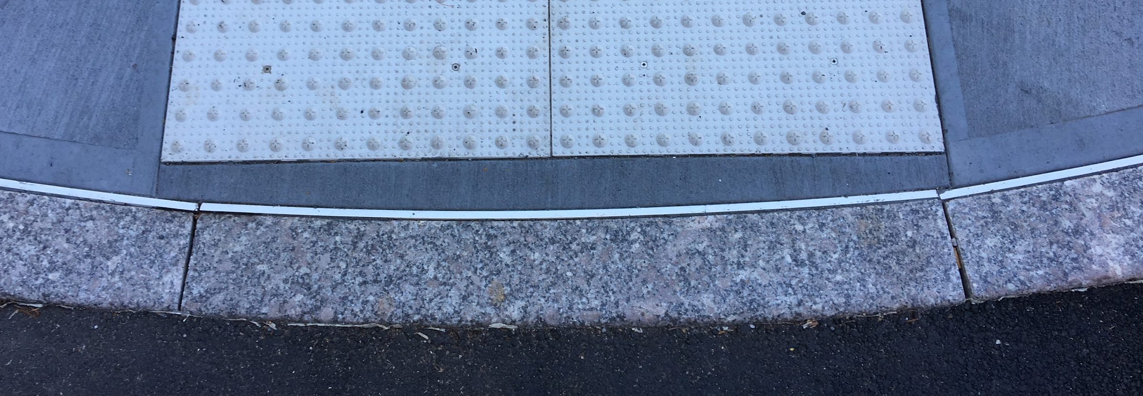
Detectable
Warning
Tiles
Designed and presented by: Liz and Sai

Slide 2
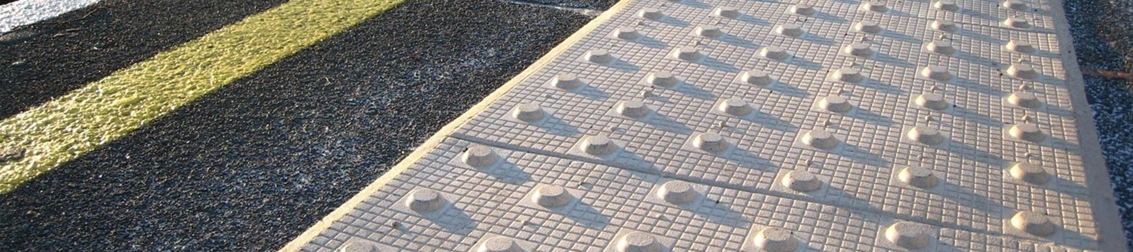
What is it?
Tactile tiles are used to guide blind and visually impaired people through public spaces in their everyday life.
Tactile ground surface indicators are designed to enable people with impaired vision to identify their own position, hazardous locations and the direction in which to walk. That visually impaired people can remember detect, identify and remember a limited number of different tactile paving surfaces and the meanings assigned to them.
photo source: http://www.visulsystems.com/products/surface-mounted-tactile-paving/
Notes:
http://www.visulsystems.com/products/surface-mounted-tactile-paving/

Slide 3
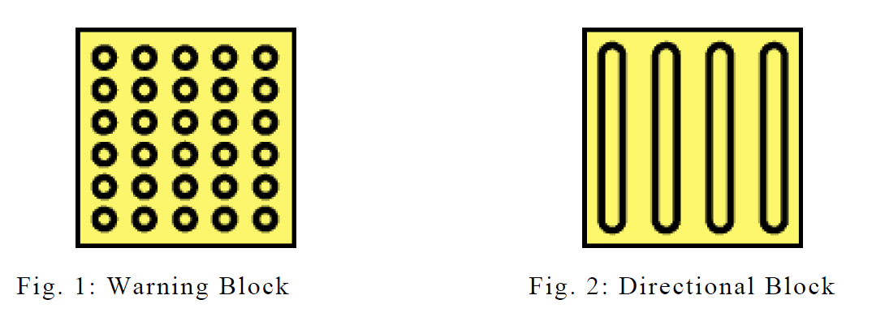
How does it work?
Tactile warnings provide a distinctive surface pattern of truncated domes, cones or bars detectable by long cane or underfoot which are used to alert the visually impaired of approaching streets and hazardous surface or grade changes.
There are two common types of tactile ground surface indicators: warning blocks that indicate the location of hazards or destination facilities (Fig. 1) and directional blocks that indicate direction of travel (Fig 2).
Photo source: Guidebook for the Proper Installation of Tactile Ground Surface Indicators (Braille Blocks): Common Installation Errors
P7
Notes:
https://www.bbc.com/news/newsbeat-44861568
(Video: To show how it works in real life)

Slide 4
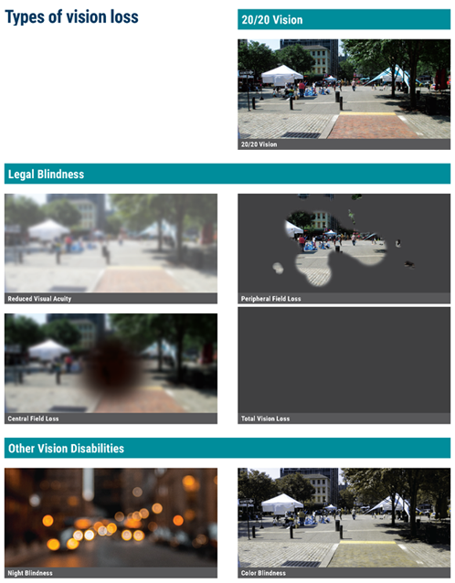
Who needs it?
How Pedestrians with Vision Disabilities Navigate:
Human guides (used in specific situations by many people)
Long white canes (2%-8%)
Dog guides (2%-5%)
Telescopes and other low vision aids
Emerging technologies
Non-visual cues:
Audible information
Detectable edges
Information received through touch (such as sidewalk, ramp, or driveway slopes, or tactile walking surface indicators perceived underfoot or by use of the long cane)
Direction of the sun or wind, which sometimes aid in maintaining orientation
Movement of other roadway users
Visual contrast, via tone or color
Photo source: https://www.fhwa.dot.gov/environment/bicycle_pedestrian/publications/accessible_shared_streets/#legal
Notes:
https://www.fhwa.dot.gov/environment/bicycle_pedestrian/publications/accessible_shared_streets/#legal
under-foot detection is the most critical, because a majority of pedestrians with vision disabilities do not use a long white cane
Visual contrast is a critical element of detectability for pedestrians with low vision and color blindness.

Slide 5
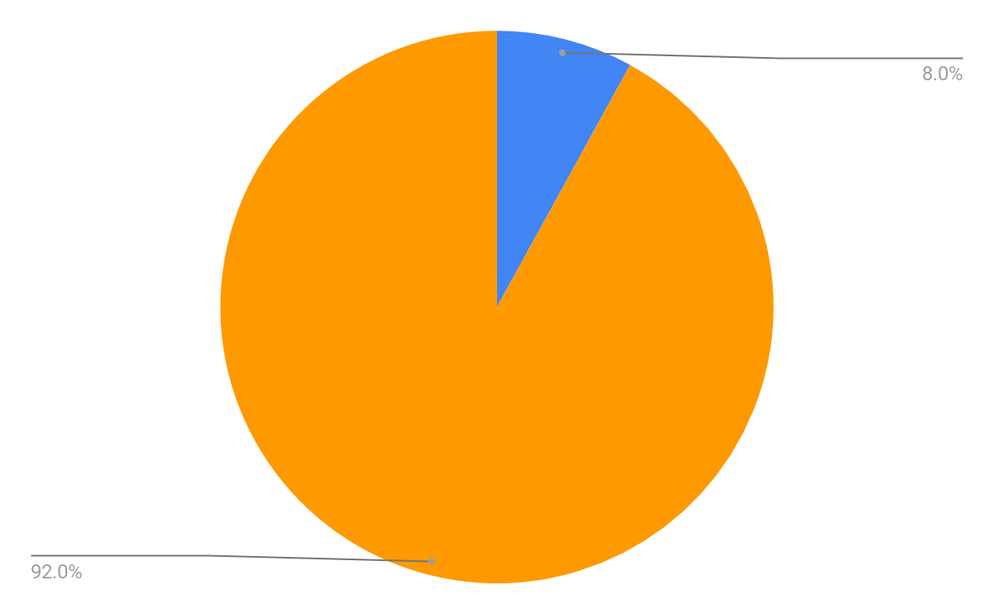
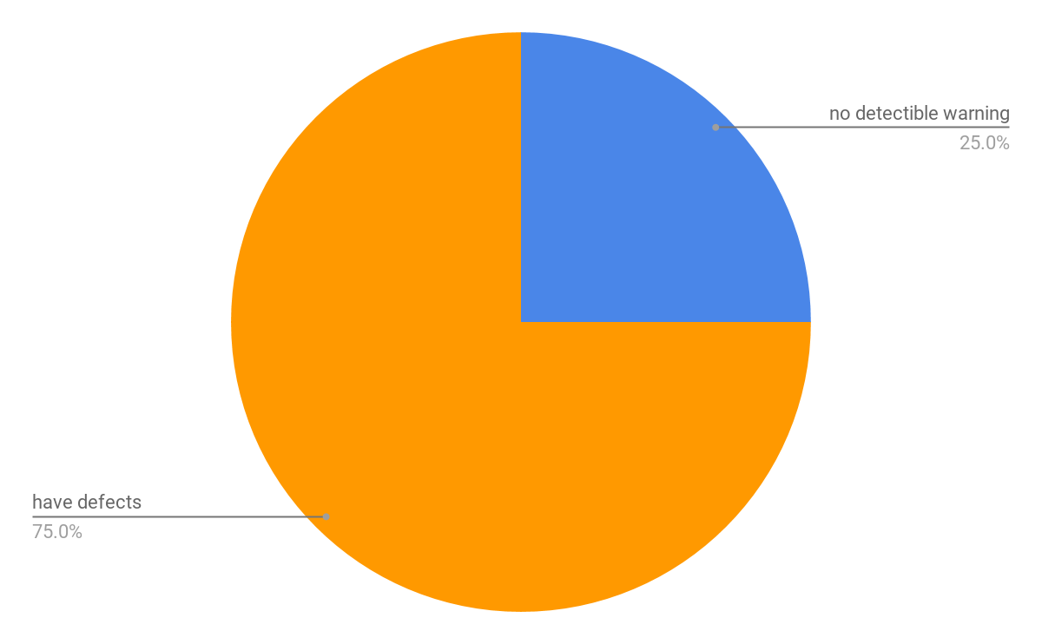
Some statistics
7,292,100
2% TO 8%
2.3% or 7,292,100
25%
Most people who are visually impaired don’t use a white cane. In fact, only an estimated 2 percent to 8 percent do. The rest rely on their useable vision, a guide dog or a sighted guide.
The number of non-institutionalized, male or female, ages 16 through 75+, all races, regardless of ethnicity, with all education levels in the United States reported to have a visual disability in 2015.
80% of curb cuts are not ADA compliant. The City’s data reveals that 75% of curb cuts have defects related to slope, width, etc., and 25% have no detectible warning tiles used primarily by people who are blind.
Notes:
http://www.perkins.org/stories/10-fascinating-facts-about-the-white-cane
https://nfb.org/blindness-statistics
https://www.nytimes.com/2017/10/08/nyregion/new-york-city-sidewalks-disabled-curb-ramps.html
https://dralegal.org/press/court-report-confirms-dismal-state-sidewalks-disabled-new-yorkers/
1.At one time or another, most people who are blind will make use of the human guide technique (sometimes referred to as a sighted guide), in which a person with sight serves as a guide to a person who is blind or visually impaired.

Slide 6

A brief history
1965: First developed in Japan
Shiichi Myakka, Okayama City, Japan, developed tactile tiles. Two years later he installed them on a busy roadway to help a visually impaired friend.
1973: Japanese government begins installing tiles nationwide
Tiles were popularized by the Japan Railway’s implementation of detectable warnings on train platforms
1990: Tactile paving introduced in the UK
Though the Disability Discrimination Act became law in 1992, the UK adapted guidance on the use of tactile surfaces in 2007
Tile image at left: https://www.adasigndepot.com/products/truncated-domes-surface-applied-2x3?utm_source=googlepepla&utm_medium=adwords&id=183074957338&gclid=EAIaIQobChMIqsyo9trP3gIVjo3ICh1LDAipEAQYAiABEgIoiPD_BwE
Notes:
How it was developed?
A system of tactile paving was first instituted at pedestrian crossings and other hazardous road situations by Japan. Shiichi Myakka, a hotel owner in Okayama City, had a close friend who was visually impaired. He developed tactile tiles to keep his friends safe on the streets.
https://www.popularmechanics.com/technology/infrastructure/a24684/the-secret-history-of-tactile-pavement/
http://www.hse.gov.uk/research/hsl_pdf/2005/hsl0507.pdf
https://medium.com/@dismediachik/the-long-road-to-a-brighter-future-76ed373dc9b9
https://www.fhwa.dot.gov/environment/bicycle_pedestrian/resources/dwm.cfm

Slide 7
1990: Detectable warnings required by ADA in US
“A suspension was placed on requiring detectable warnings at curb ramps and hazardous vehicular ways, but not for transit platform edges. The reason for the suspension was to conduct research on the performance of their detectability. The DOJ continued the suspension through July 26, 2001, which allowed 10 years for conducting research.” - https://www.fhwa.dot.gov/environment/bicycle_pedestrian/resources/dwm.cfm
The research determined that other designs used in place of truncated domes such as grooves, striations, and exposed aggregate, were not detectable in the sidewalk and roadway environment because of the similarities to other surface textures and defects. Truncated domes have a unique design that can be detected underfoot and with a cane, and other surfaces are not considered ADA equivalent and therefore do not comply with the ADA requirements.
Notes:
https://www.fhwa.dot.gov/publications/publicroads/04sep/10.cfm (law)

Slide 8
ADA standard
705.1 General. Detectable warnings shall consist of a surface of truncated domes and shall comply with 705.
705.1.1 Dome Size. Truncated domes in a detectable warning surface shall have a base diameter of 0.9 inch (23 mm) minimum and 1.4 inches (36 mm) maximum, a top diameter of 50 percent of the base diameter minimum to 65 percent of the base diameter maximum, and a height of 0.2 inch (5.1 mm).
705.1.2 Dome Spacing. Truncated domes in a detectable warning surface shall have a center-to-center spacing of 1.6 inches (41 mm) minimum and 2.4 inches (61 mm) maximum, and a base-to-base spacing of 0.65 inch (17 mm) minimum, measured between the most adjacent domes on a square grid.
705.1.3 Contrast. Detectable warning surfaces shall contrast visually with adjacent walking surfaces either light-on-dark, or dark-on-light
Notes:
http://accessforblind.org/detectable-warnings/

Slide 9
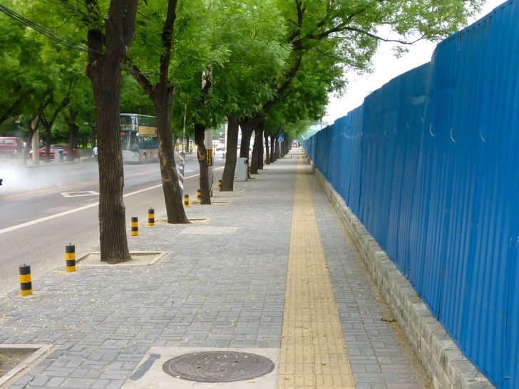
History - continued
1992: Australia approves tactile design standard Tactile ground surface indicators for the orientation of people with vision impairment
1995-2001: Blind lanes installed in some Chinese cities
Tiles were first installed in Beijing in the 1980s by the China Disabled Persons’ Federation. In 2001 a law was passed requiring new roads in cities to include ‘blind lanes.’
Other countries using tactile tiles:
Canada
Mexico
Hong Kong
Indonesia
Malaysia
South Korea
Taiwan
Thailand
India
New Zealand
Belgium
France
Italy
Netherlands
Turkey
‘Blind lane’ in China
Photo source: https://99percentinvisible.org/article/death-tactile-paving-chinas-precarious-paths-visually-impaired/
Notes:
https://99percentinvisible.org/article/death-tactile-paving-chinas-precarious-paths-visually-impaired/
China: The first reason of its nationwide use is the 2005 National Civilized City Selection. Among the factors assessed, the coverage of the blind road is an important indicator of whether the city is civilized. The other is the selection of “National Accessible Building Cities”.
Besides, other Accessible Pedestrian Signals are hard to see in China.
The use of blind passages requires cooperation and assistance from a range of support projects. Observe whether a blind road in a country really serves the blind, not on the mileage and coverage of the blind road, but on whether the relevant supporting facilities are perfect.

Slide 10
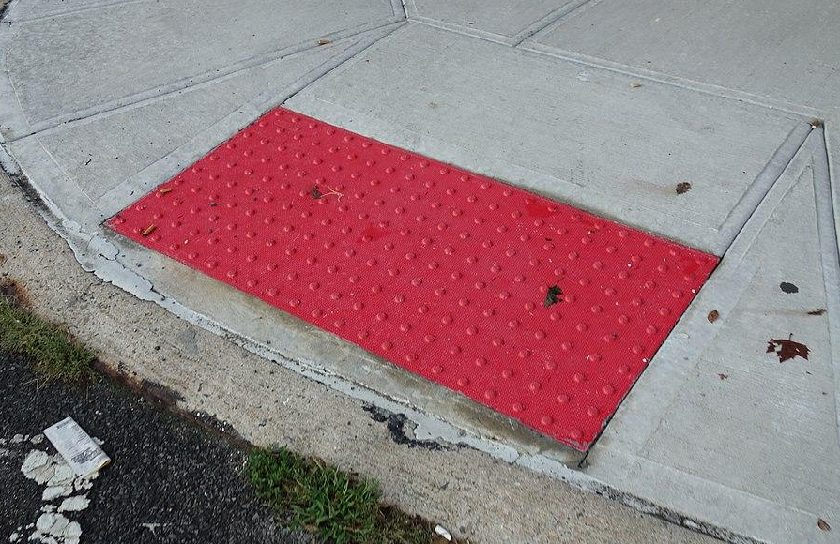
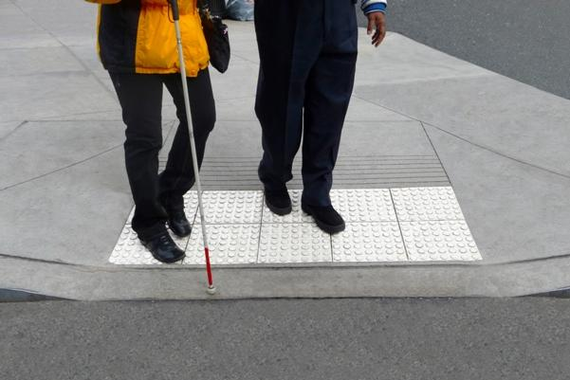
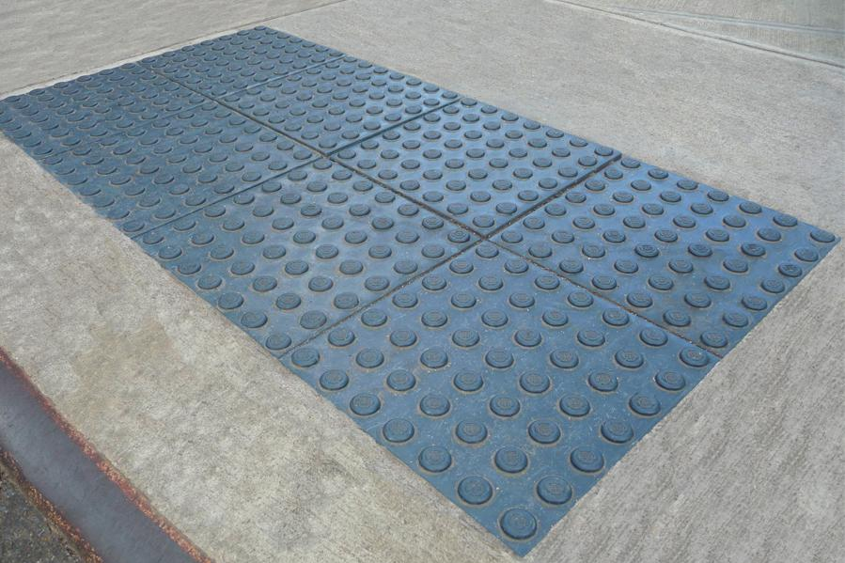
Why do they have different color?
The ADA (Americans with Disabilities Act) does not have a set color requirement for tactile raised warning systems. What this means is that municipalities, businesses, and other parties are responsible for ensuring tactile warning surfaces are installed where required by federal laws, and that they are essentially free to choose any color or combination of colors they desire, so long as the colors contrast with the surrounding surfaces.
The use of these colors is often for aesthetic reasons and, typically, does not have any specific role or purpose tied to the color.
Photo source: https://commons.wikimedia.org/wiki/Category:Tactile_paving_in_New_York_City
Notes:
https://adatile.com/certain-colors-used-tactile-detectable-warning-surfaces/

Slide 11
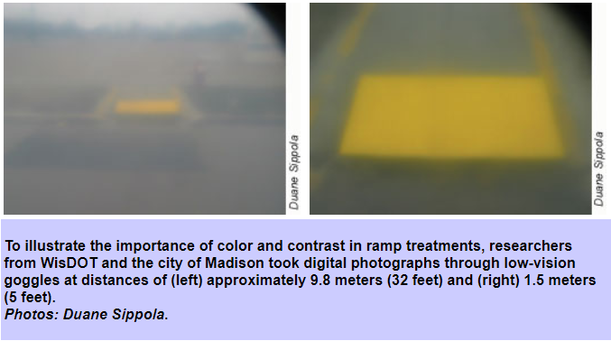
Does the Choice of Color Really Matter?
In 2000, the U.S. Access Board published Detectable Warnings: Synthesis of U.S. and International Practice, a report indicating that "safety yellow is a color that is standardized for use as a warning in the pedestrian-highway environment."
Yellow and white could be seen at the farthest distances, in most cases, the width of a residential street, 32 to 45 feet [9 to 14 meters]. It seems that low-vision persons do notice the yellow color on signposts and curbs. Since all crosswalk lines are painted white, it seems to make sense that domed ramps should be yellow to provide the necessary contrast.
Photo source: https://www.fhwa.dot.gov/environment/bicycle_pedestrian/publications/accessible_shared_streets/#legal
Notes:
https://www.fhwa.dot.gov/publications/publicroads/04sep/10.cfm

Slide 12
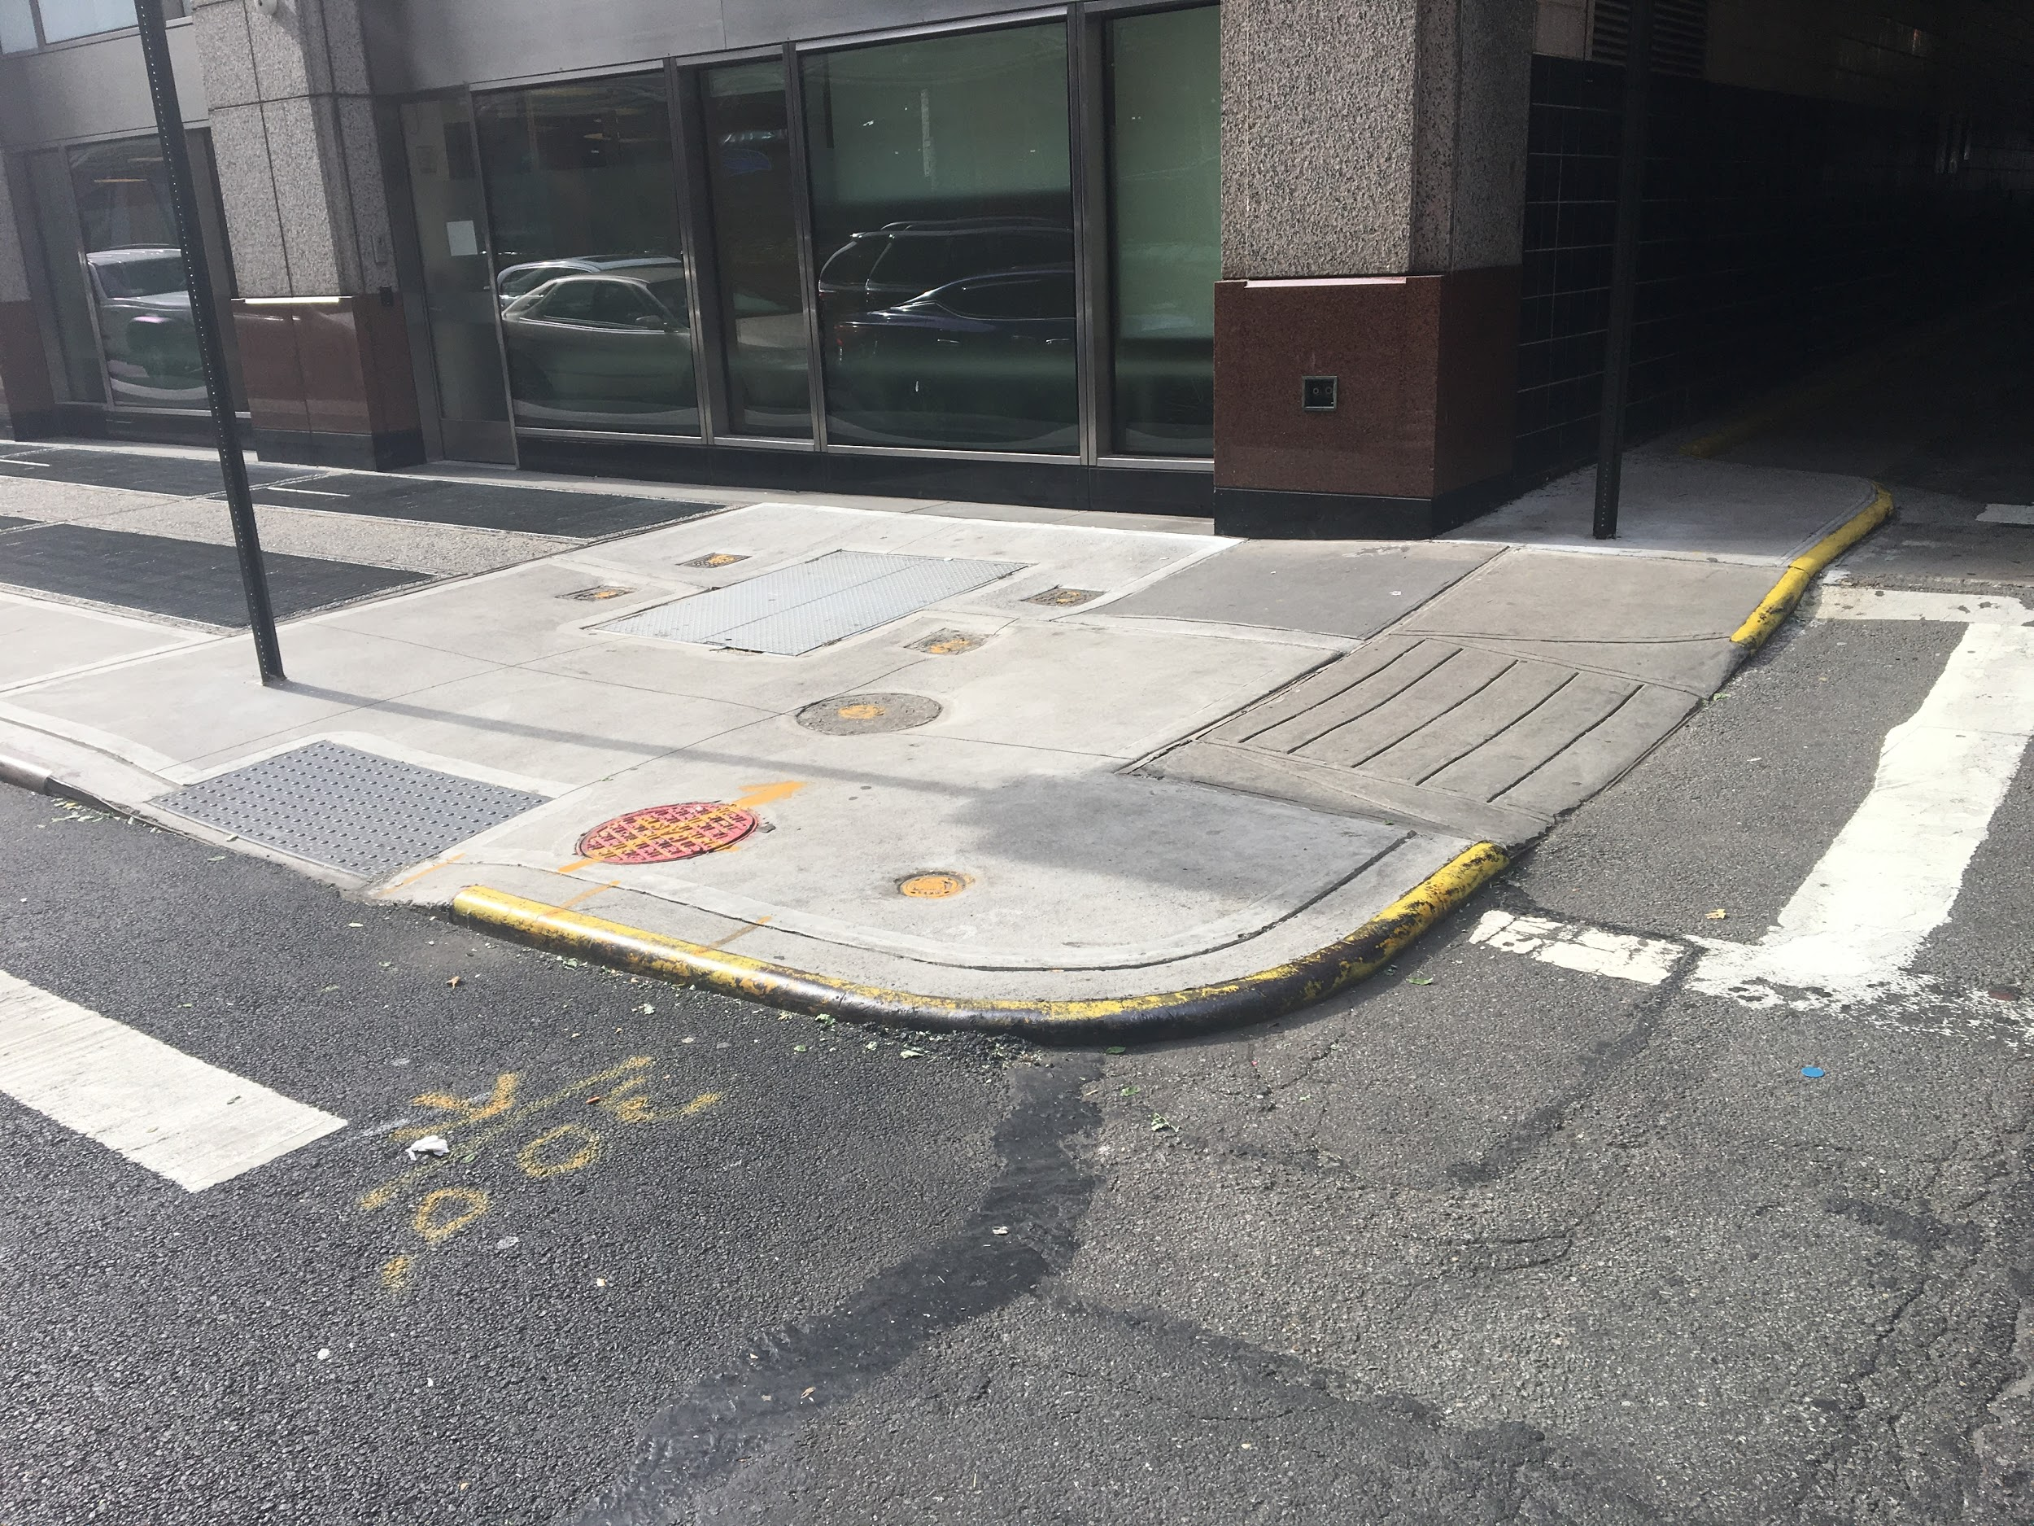
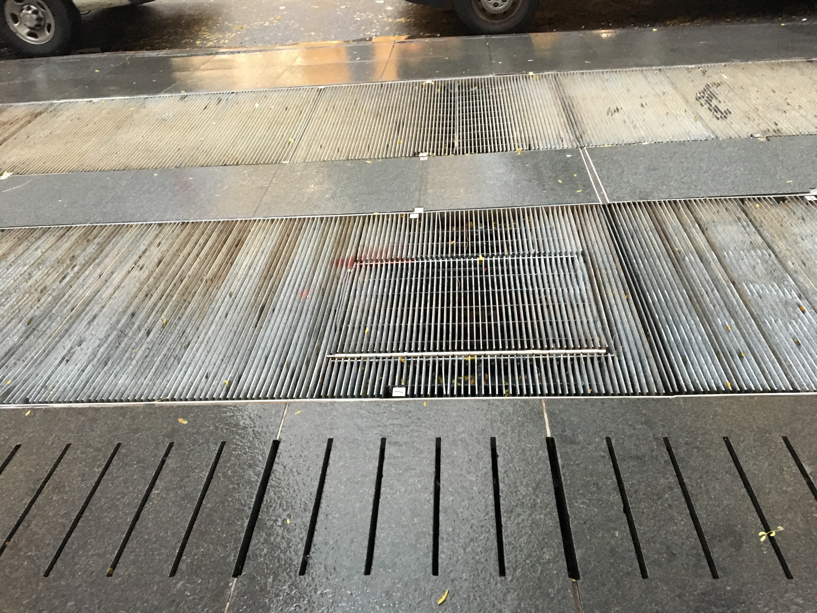
Tactile jumble
Defining a common code of textures is a challenge in older cities, where an array of pathway patterns already exists.
At left, ventilation grates on a New York City sidewalk

Slide 13

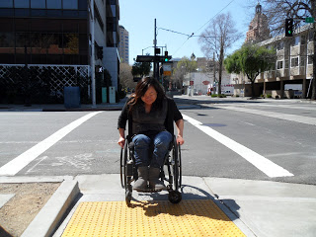
The tile debate
Common complaints
Some wheelchair users experience increased resistance on curb ramps
Vibration of wheelchair as a result of tiles often causes discomfort to people with spinal cord injuries
Tiles pose a hazard to anyone with balance issues
Photo source: http://atnetworkblog.blogspot.com/2012/03/pros-and-cons-of-truncated-domes-should.html
Notes:
Info on spinal cord injury: http://atnetworkblog.blogspot.com/2012/03/pros-and-cons-of-truncated-domes-should.html

Slide 14
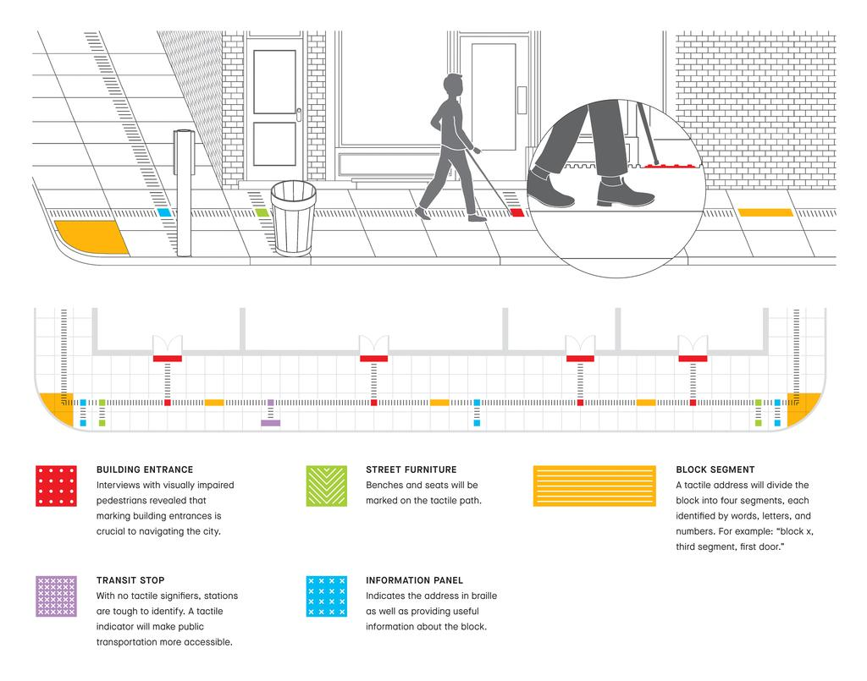
Future-Tactile City
The system would use paving with different textures to indicate points of interest, such as a bus stop, a garbage can, a sign, or an entrance to a building.
Photo source: https://collection.cooperhewitt.org/objects/1159162485/
Notes:
The Sense: Design Beyond Vision:
https://www.youtube.com/watch?v=lJAmnwGzD54&index=18&list=PLqwPGOOIhKSDz4jg8xgZlU-CPkAabFZLl

Slide 15
Additional Reference
https://99percentinvisible.org/article/death-tactile-paving-chinas-precarious-paths-visually-impaired/x
Marion A. Hersh, , Michael A. Johnson, , and David Keating. Assistive Technology for Visually Impaired and Blind People. P. 321, 10.1.2 Acessible Environments: An Overview. Springer, 2008-01-01.
Barbara Silverstone, Mary Ann Lang, Bruce Rosenthal, Eleanor E. Faye. The Lighthouse Handbook on Vision Impairment and Vision Rehabilitation. Oxford University Press, USA, Apr 13, 2000. p 607-614
https://www.ada.gov/pcatoolkit/chap6toolkit.htm
https://www.fhwa.dot.gov/environment/bicycle_pedestrian/resources/dwm.cfm
https://www.access-board.gov/guidelines-and-standards/streets-sidewalks/public-rights-of-way/background/state-dot-curb-ramp-standard-drawings-with-detectable-warning-details
https://www.access-board.gov/guidelines-and-standards/streets-sidewalks/public-rights-of-way/guidance-and-research/visual-detection-of-detectable-warning-materials
https://www.simplemost.com/sidewalk-bumps/
https://therantyhighwayman.blogspot.com/2015/02/tricky-tactiles.html
http://atnetworkblog.blogspot.com/2012/03/pros-and-cons-of-truncated-domes-should.html
Notes:
The Sense: Design Beyond Vision:
https://www.youtube.com/watch?v=lJAmnwGzD54&index=18&list=PLqwPGOOIhKSDz4jg8xgZlU-CPkAabFZLl

